Slide 1
Welcome to my world…
it may not seem like much now, but it means a lot to me…
if you look in the right places, you may discover something new…
little details, a hidden story…
see what you can click…
and enjoy the world from my eyes…

Slide 2
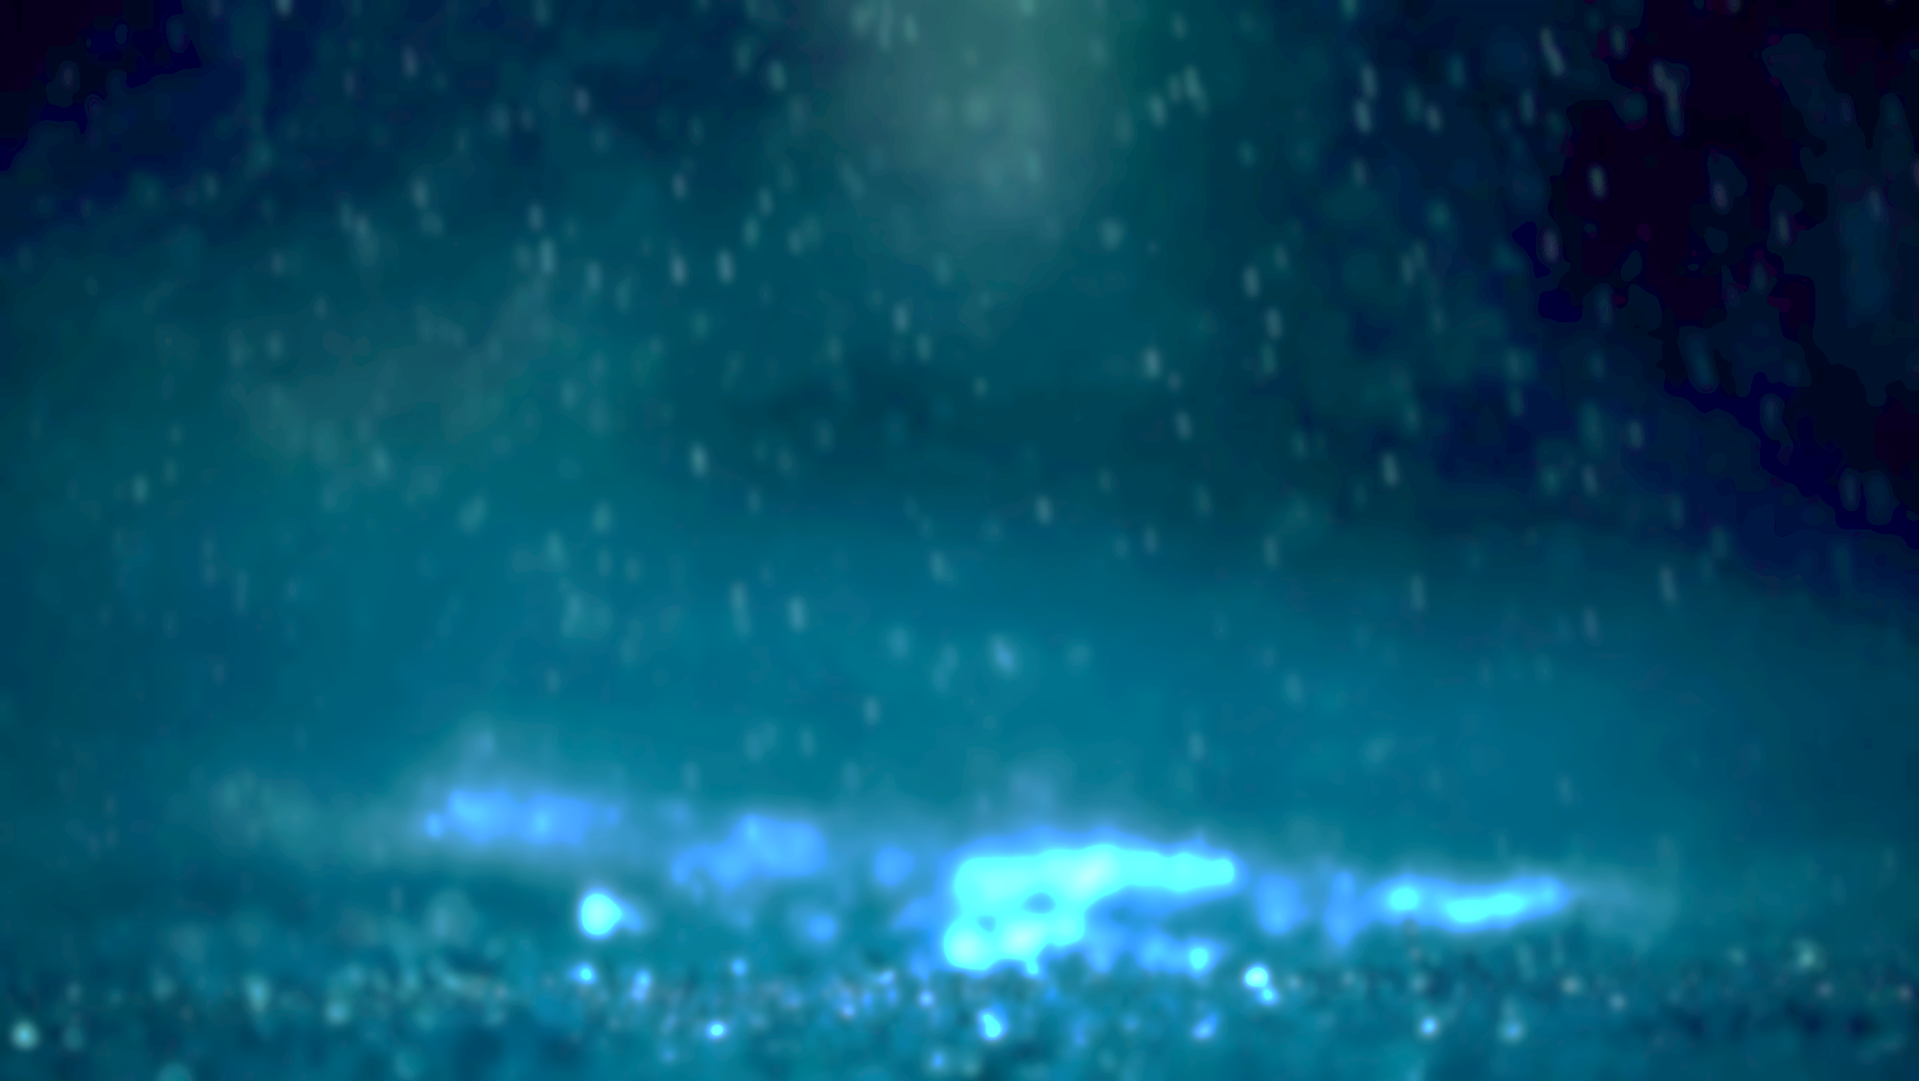

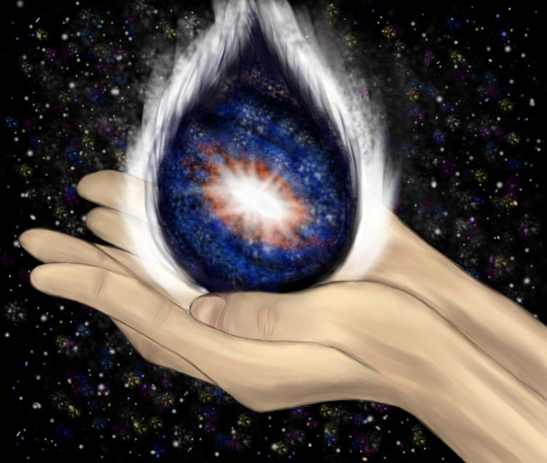
This was a piece of digital art I created inspired by the song, “Tears from Polaris”. I love the idea that we can create our own dreams and aim for anything, because often what matters to us the most is right within grasp.
art is like raindrops
on a Summer evening stroll
or, like, a haiku
Art
if you never reach
the stars, make instead your own
universe of lights
Reframing

Slide 3

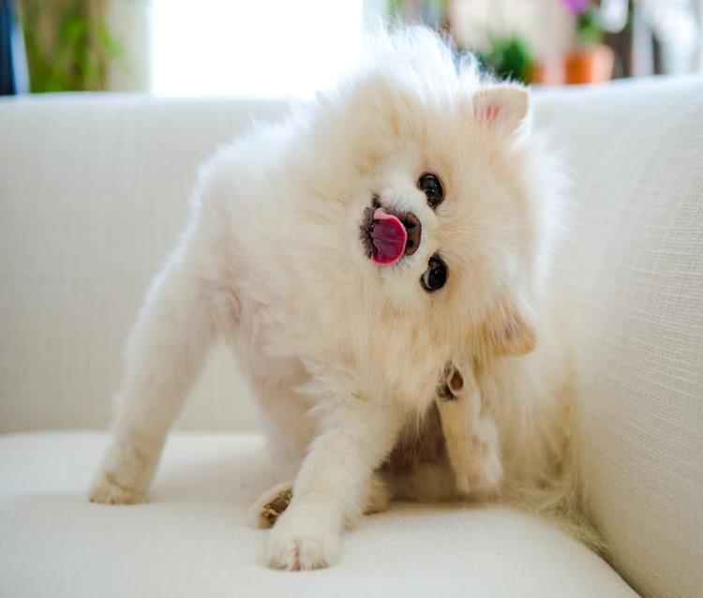
This is my dog, Sushi! He’s an adorably spoiled white Pomeranian with his own Facebook page (Sushi DeSu). I like to think that, like my dog, I care about those around me and set my default mood to be excited about all that life has to offer.
sleep is but a dream
but wakefulness is where your
true feelings speak out
Loyal
why cry when you can
laugh away the dreads of life
and dance in starlight
Positive
Notes:
Main sushi slide

Slide 4

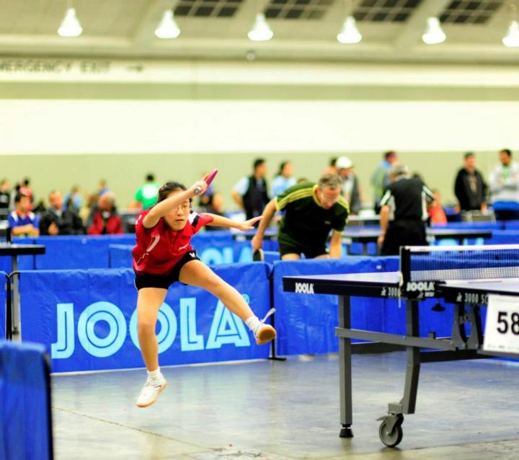
I’ve played competitive table tennis since the age of 9, and it has taught me so much about what it means to always be looking for improvement. I’ve made lifelong friends in the sport, and this is a photo from one of my favorite annual teams tournaments.
differences do not
define you, but rather, they
help to set your goals
Perseverance
if at first you don’t
succeed, figure out why, then
don’t do it again
Mindset/Attitude
Notes:
Main table tennis slide

Slide 5


This is a photo I took for a macro photography project. I loved the idea of bringing attention to small and easily overlooked, yet beautiful details in life. On the outside of my dorm room, I keep track of my “Small Happiness of the Day” to remind myself that life is full of positives if you look hard enough.
the first birdsong of
Spring, like the last leaf of Fall;
time is in your hands
Attention to Detail
Appreciating the Small Things in Life
what matters most is
not the most of matter but
what you choose to see

Slide 6


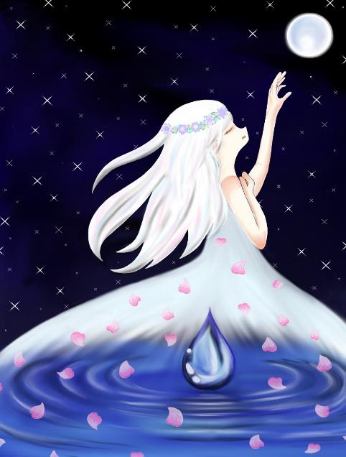
Another of my digital art pieces, I wanted to capture a dream-like scene with the girl reaching towards something physically but also mentally with her eyes closed as if she doesn’t need to see it to believe it. Life is about taking risks and going for things that may seem daunting. Otherwise, you’ll never move forward.
Dreamer
close your eyes and breathe
make a wish and seize the dream
before you let go
why did the girl fly
to the moon? To live among
the infinite stars
Curiosity

Slide 7
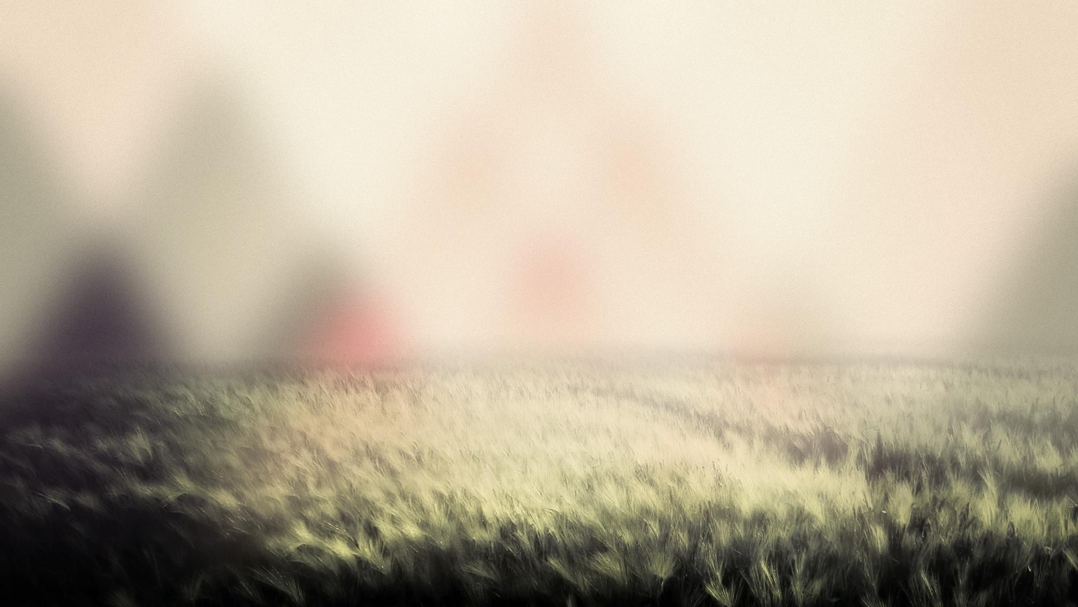
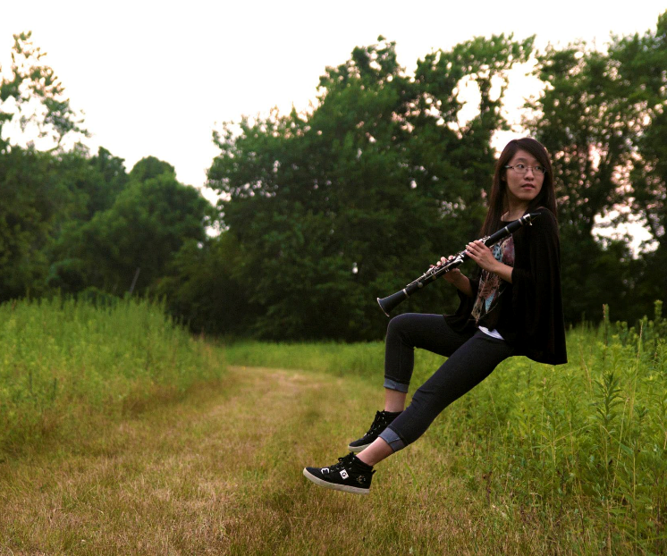
Storytelling and writing is something that speaks a lot to me, because I really feel like they’re a powerful way to communicate. Ask me about my novel and stories-in-verse and I’ll tell you about how in my mind, creativity is seeking beneath the surface level and being able to transform the vision into reality. In other words, telling a story!
there is a rhythm
like a heart beating strongly
but instead, it flies
Storytelling
a whisper of thought
like magical words singing,
sing it, to the world
Creative

Slide 8

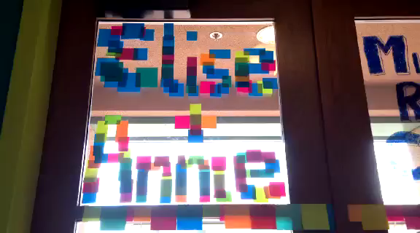
My neighbors and I are currently involved in a post-it war where we battle through making post-it art for each other’s walls/doors, and this was my first declaration of war. If I have an idea in my mind, I can’t focus on anything else until I make/do it, which results in a lot of random artistic projects and late nights writing or CADing.
Maker
post-its and scissors
and an open mind to think;
why wait? Just do it!
night falls and silence
tip-toes a while away but
you are awake
Passion

